Slide 2
Prius Real-World Trips
Trips by Duration:
Group 1, 1-5 minutes: 135 trips
Group 2, 5-10 minutes: 115 trips
Group 3, 10-20 minutes: 43 trips
Group 4, 20-30 minutes: 14 trips
Group 5, 30-40 minutes: 3 trips
Group 6, 40-50 minutes: 2 trips
Group 7, 50-60 minutes: 83 trips
Group 8, Over 60 minutes: 0 trips
Trip filtering:
Deletion of trips less than 1 minute
Deletion of trips with a mean ac consumption lower than 10 W (AC off filter)

Slide 3
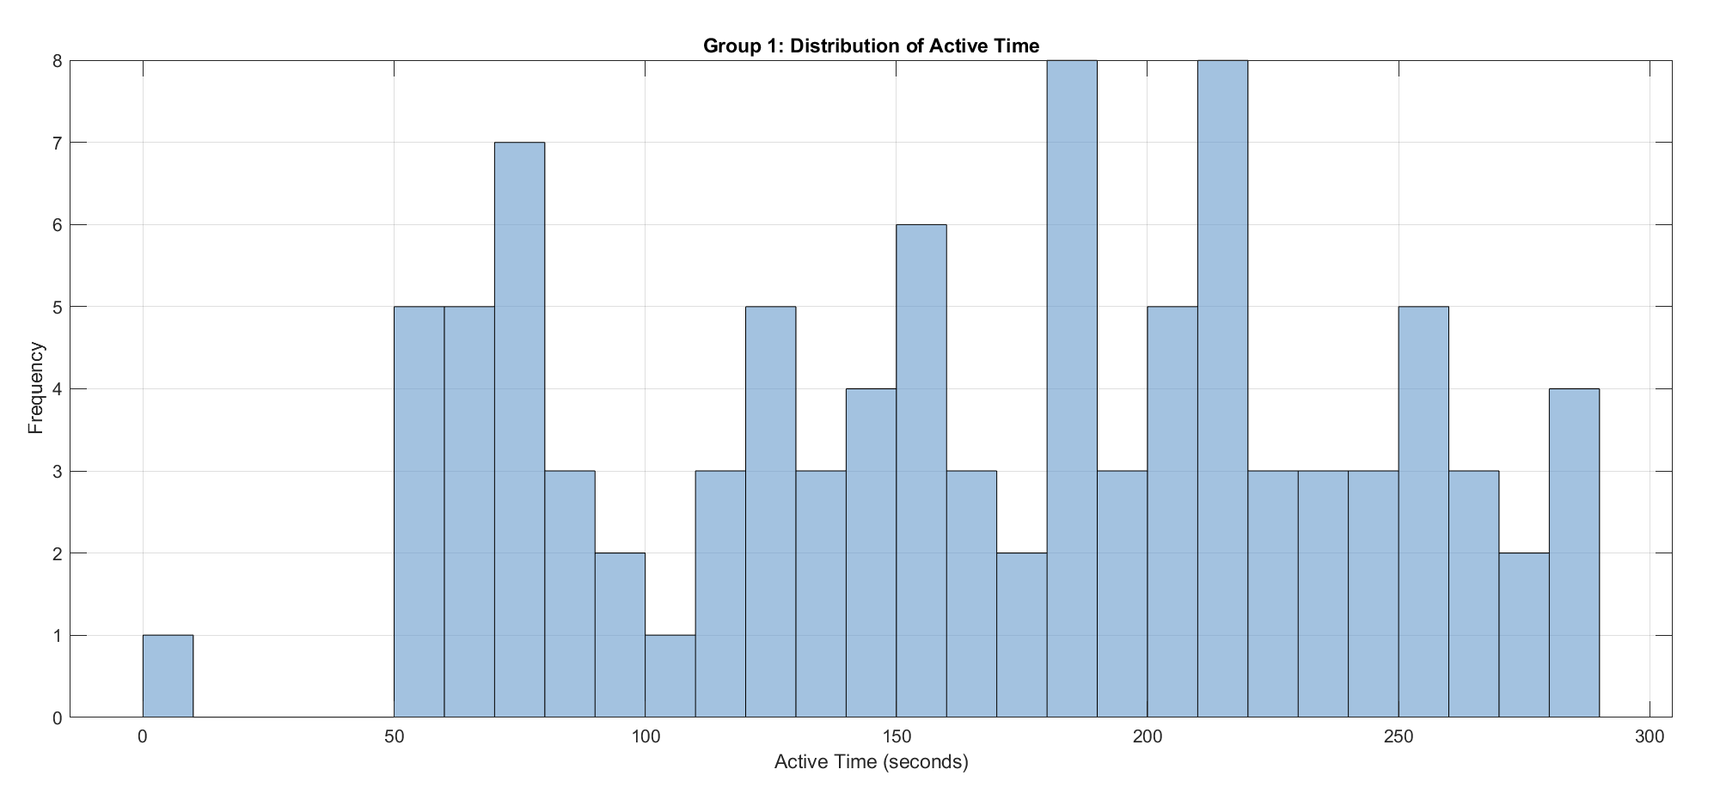
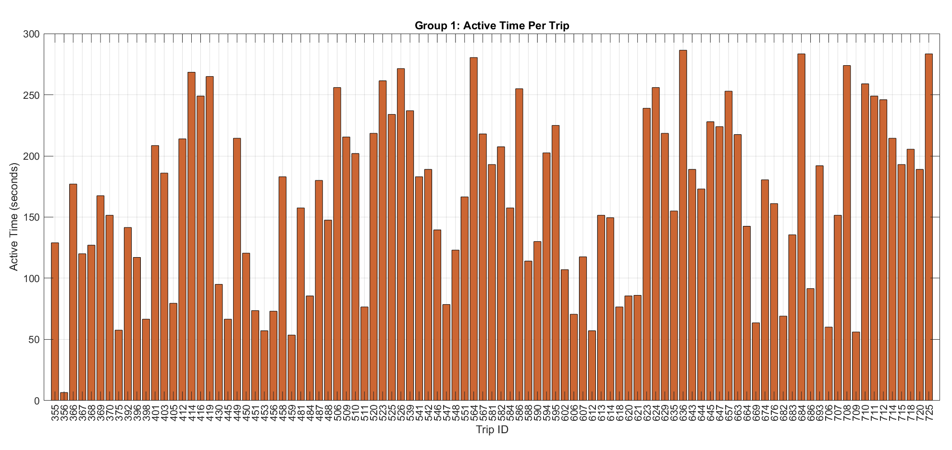
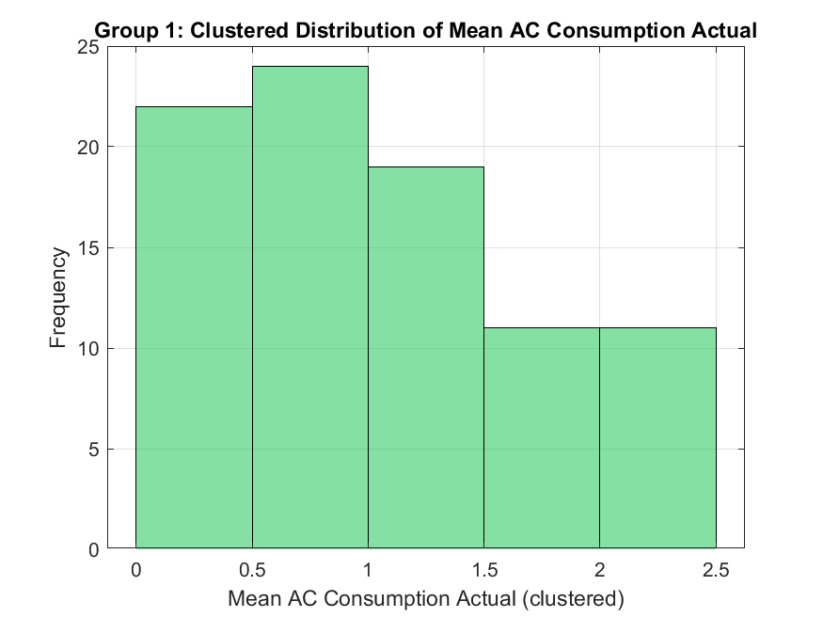
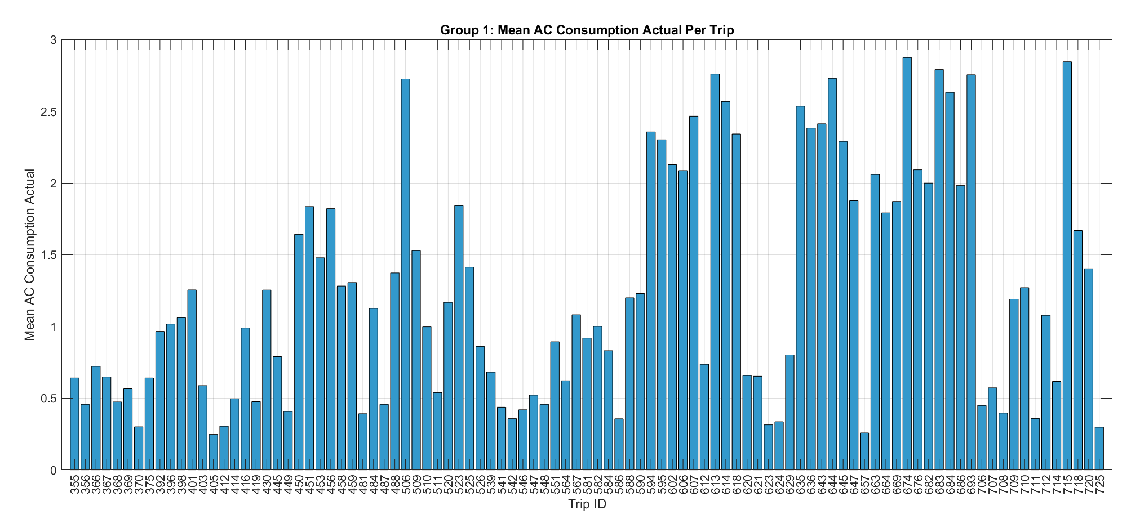
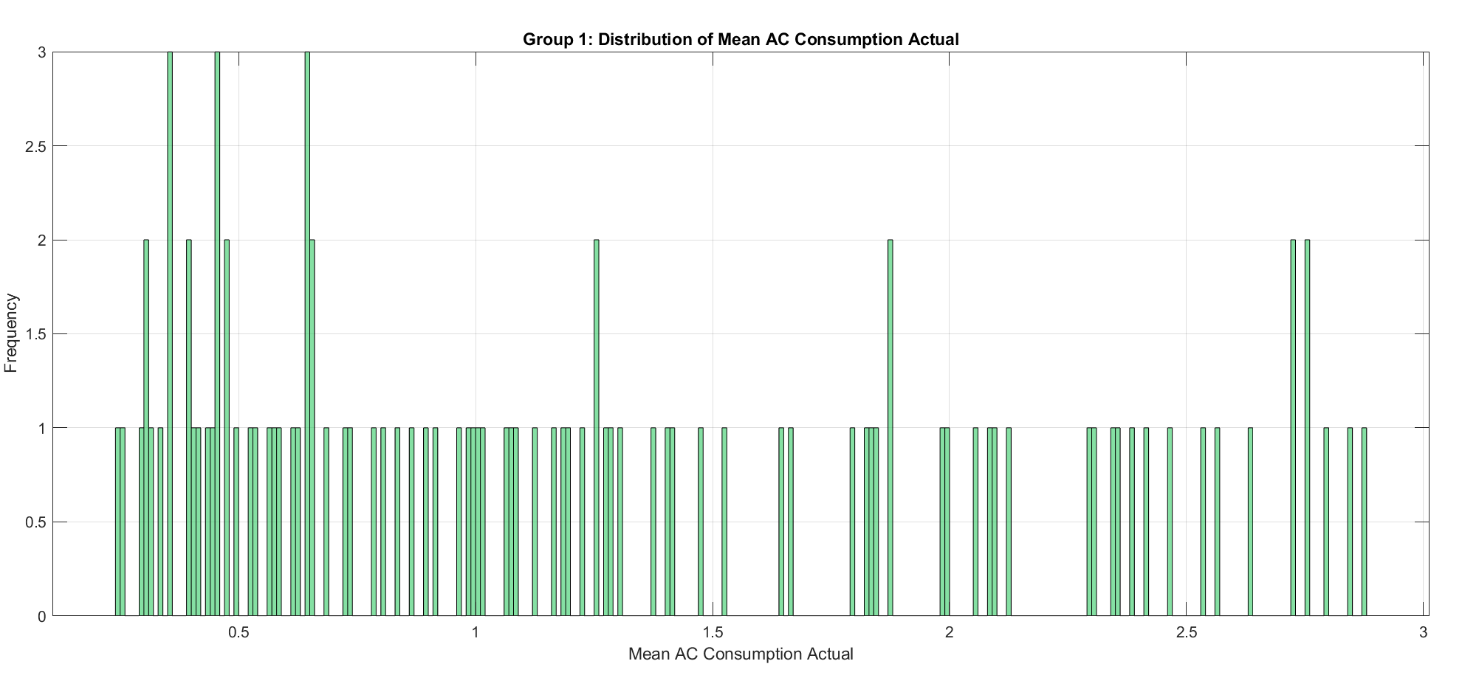
Group 1: 1-5 minutes trips

Slide 4
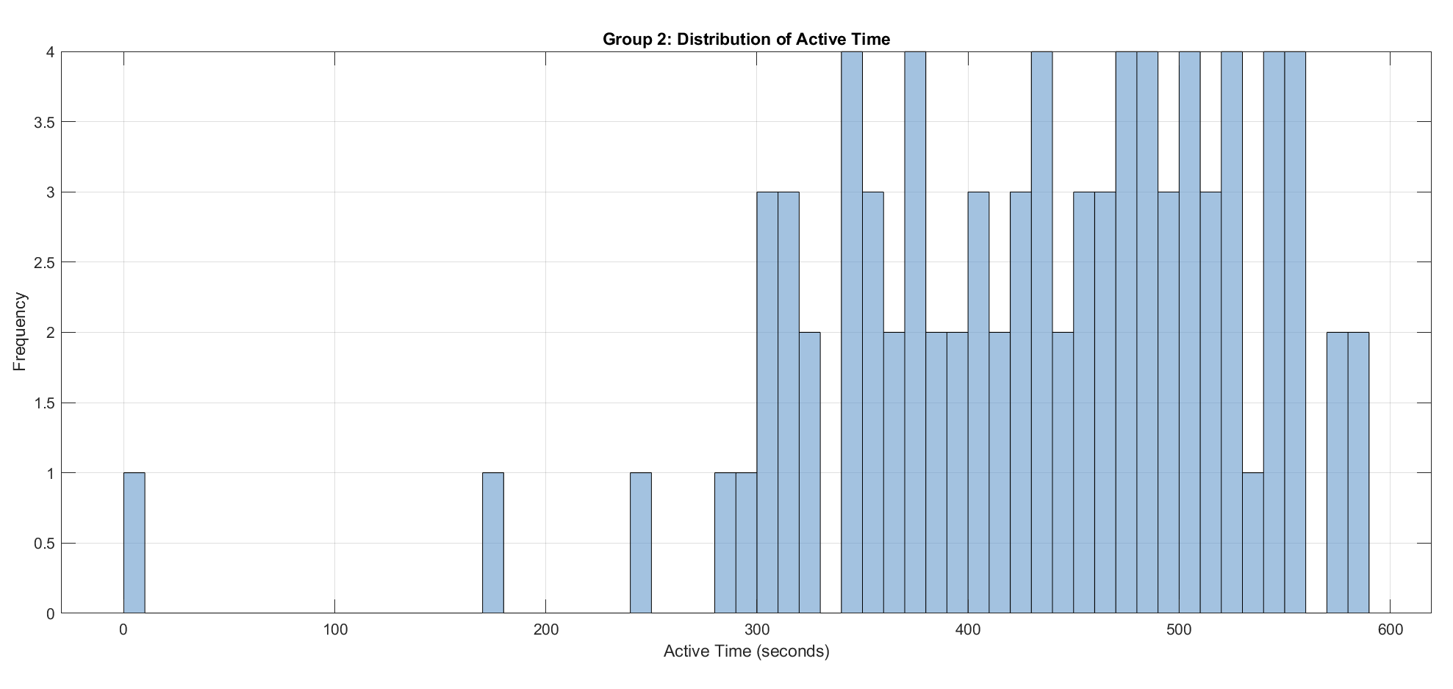
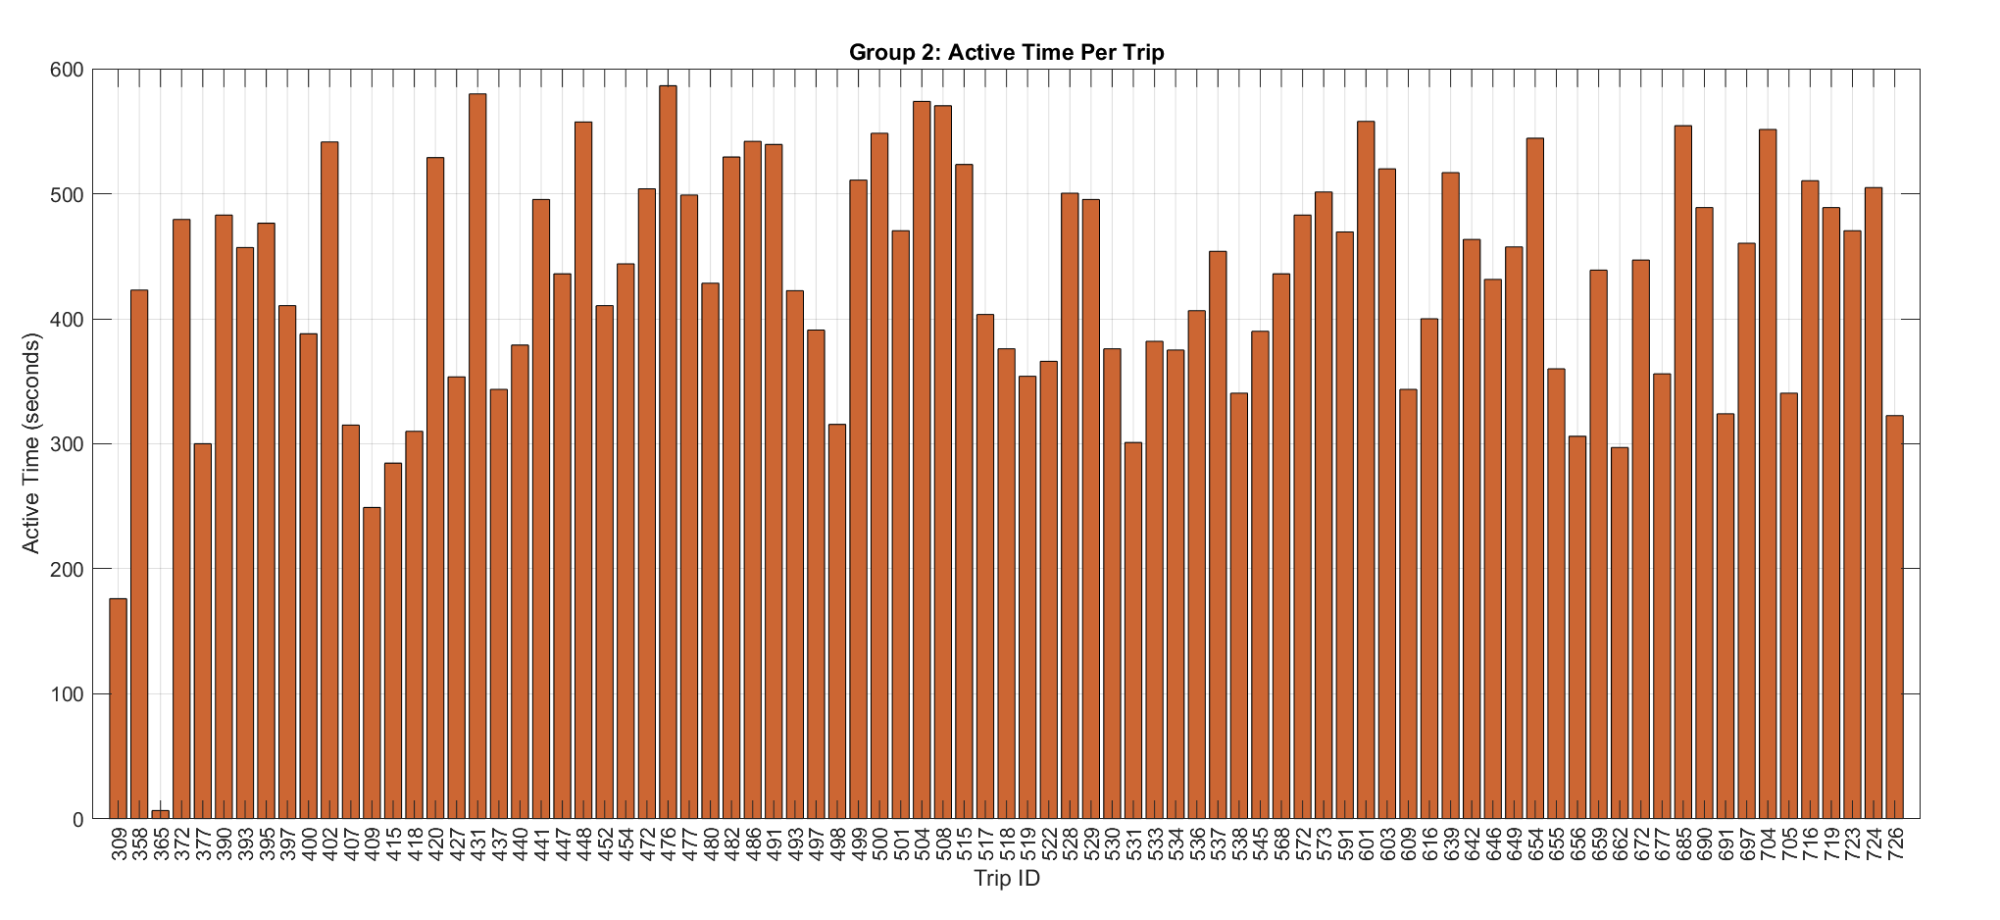
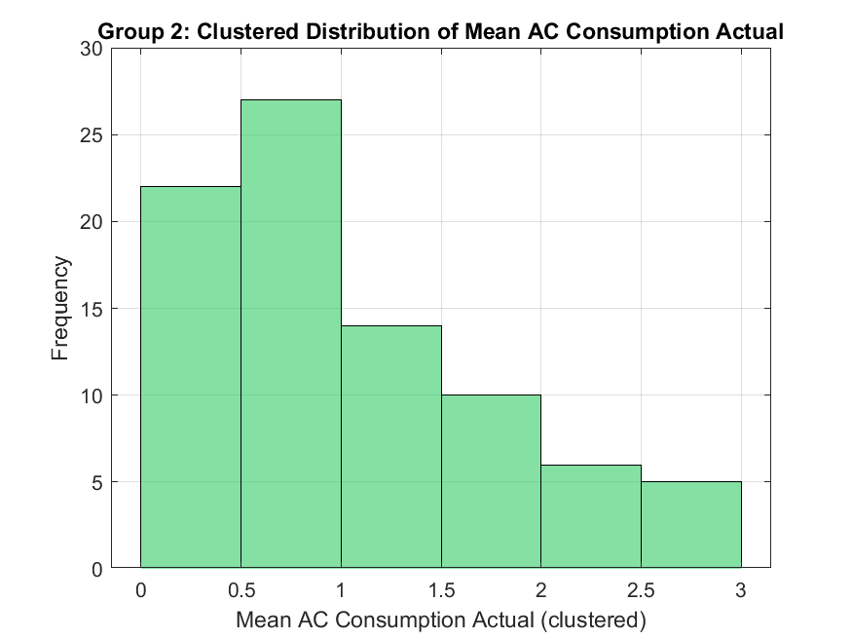
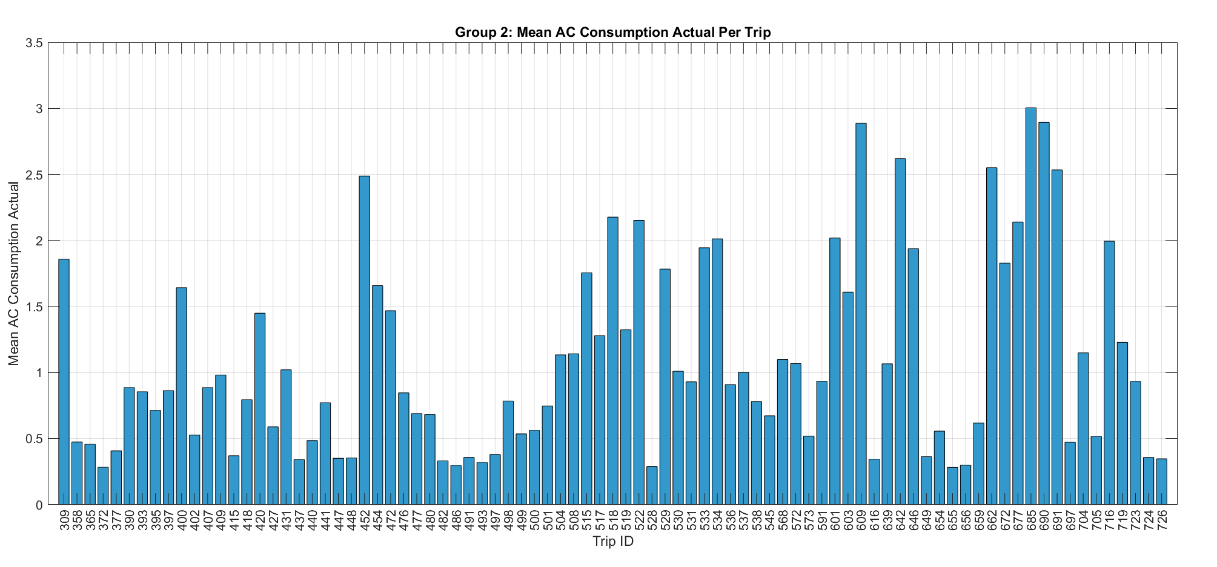
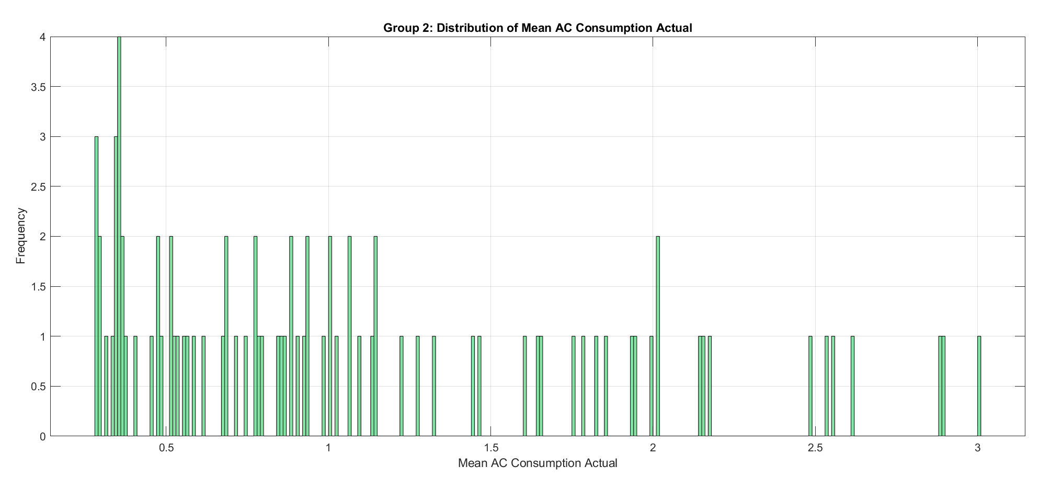
Group 2: 5-10 minutes trips

Slide 5
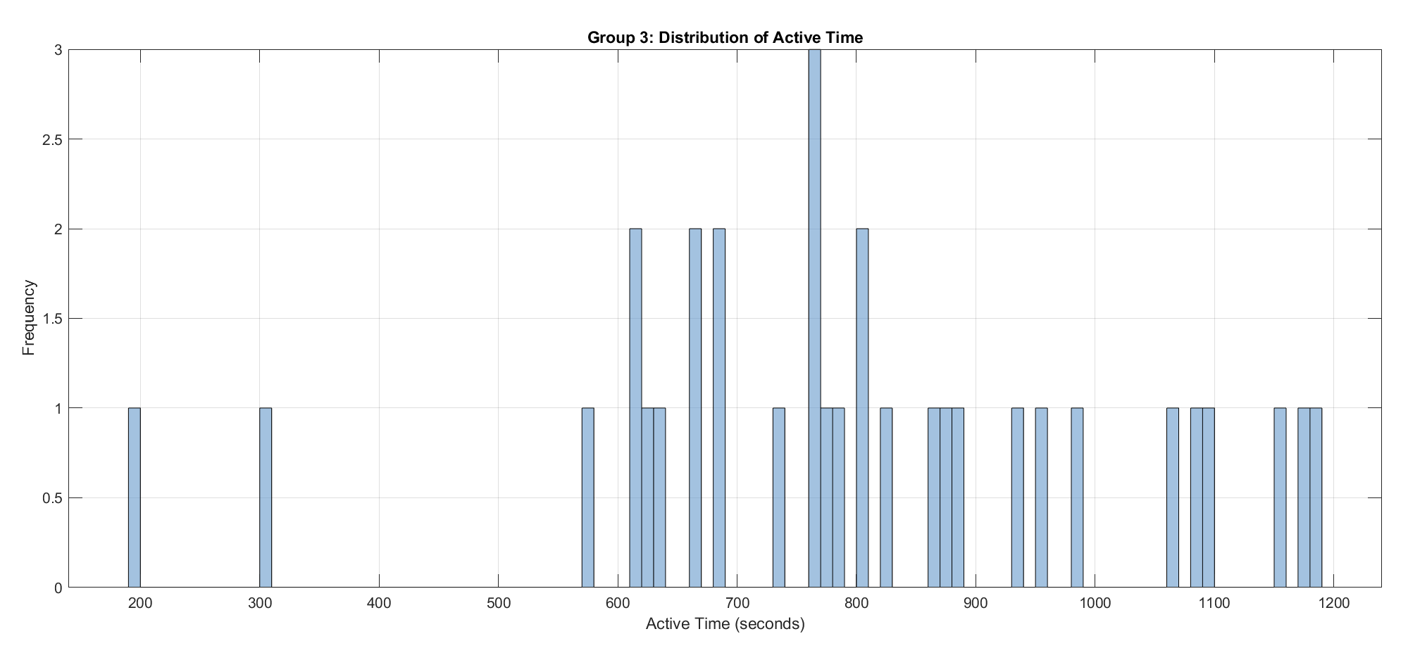
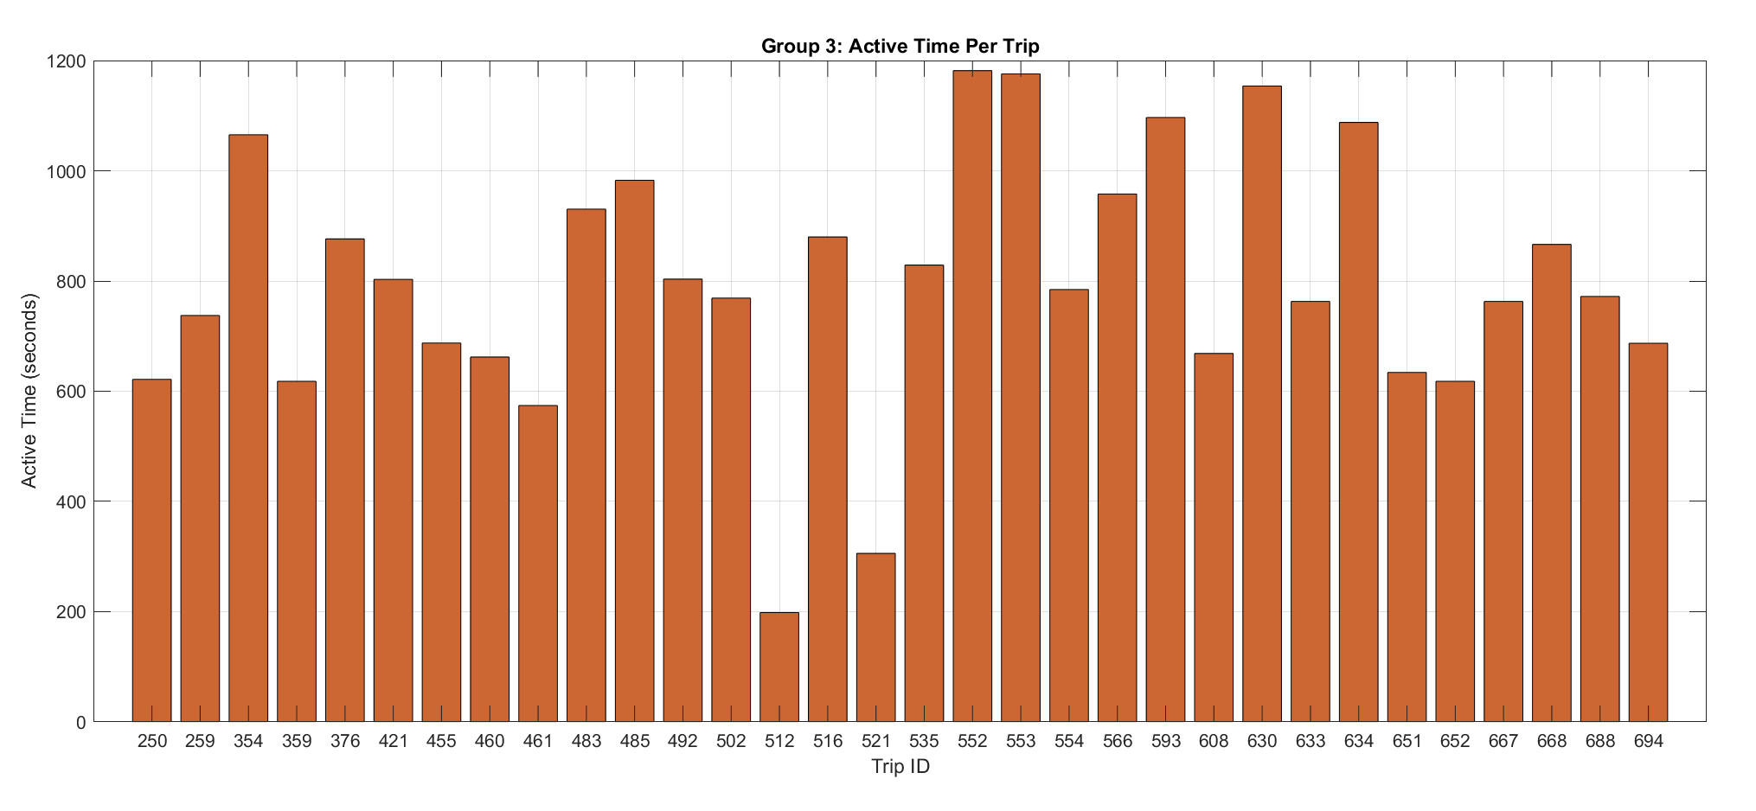
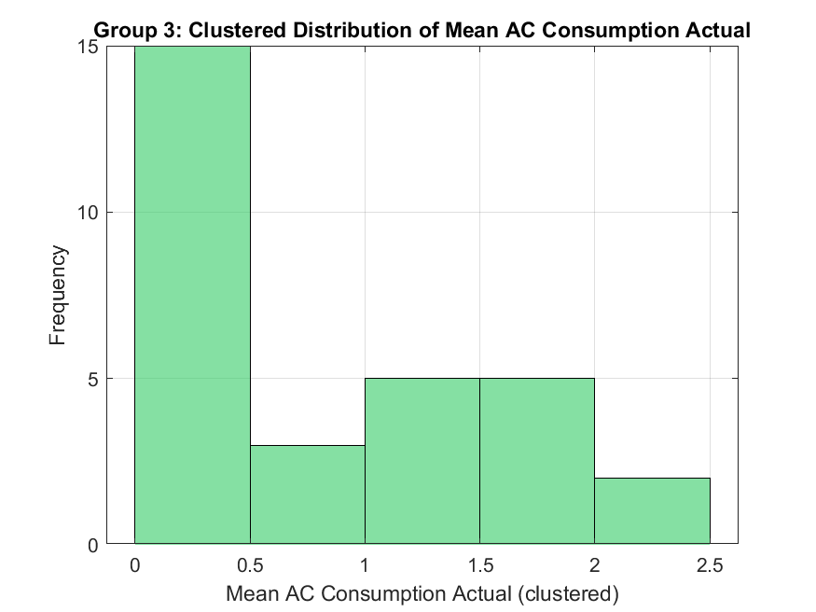
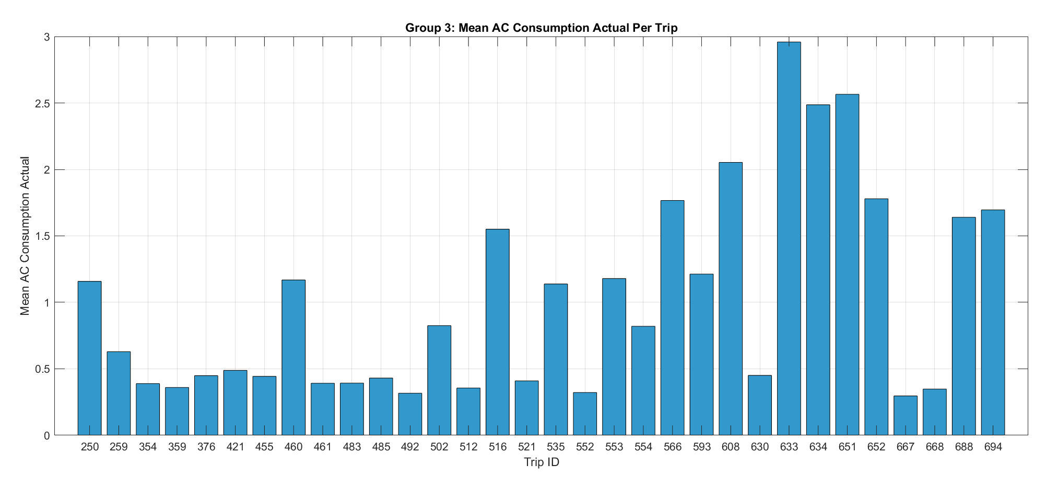
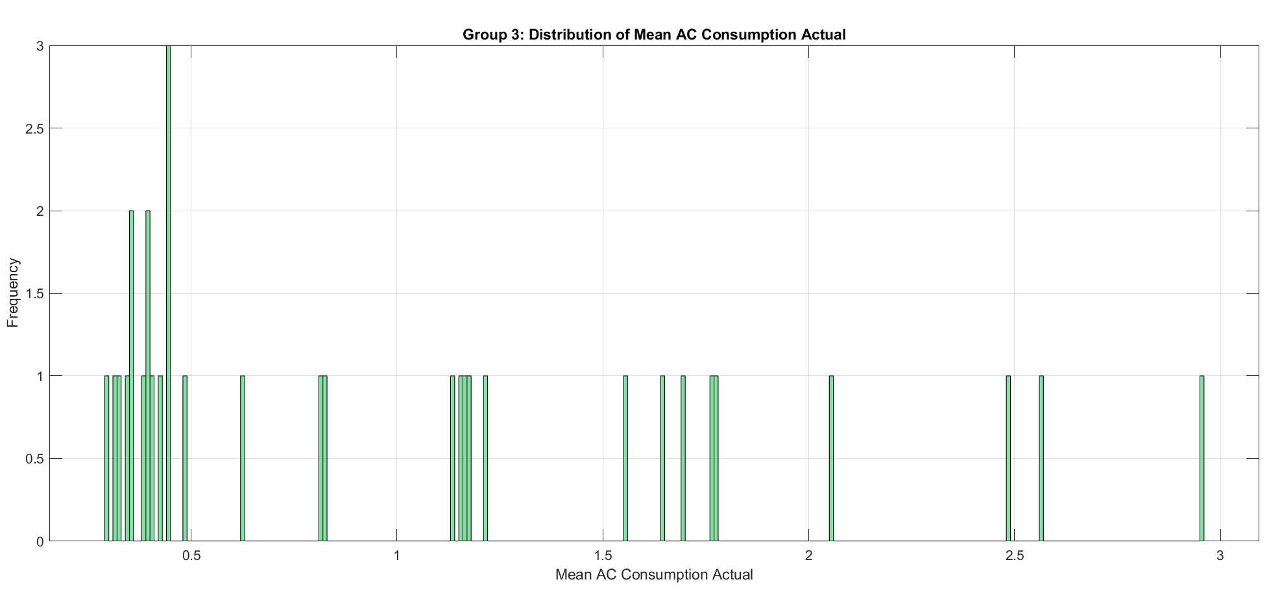
Group 3: 10-20 minutes trips

Slide 6
Group 2: 5-10 minutes trips

Slide 7
Group 2: 5-10 minutes trips

Slide 8
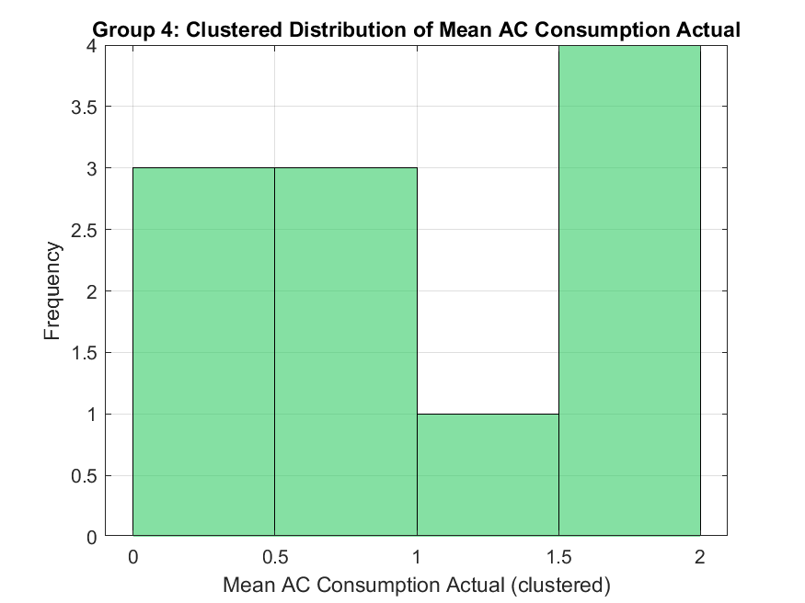
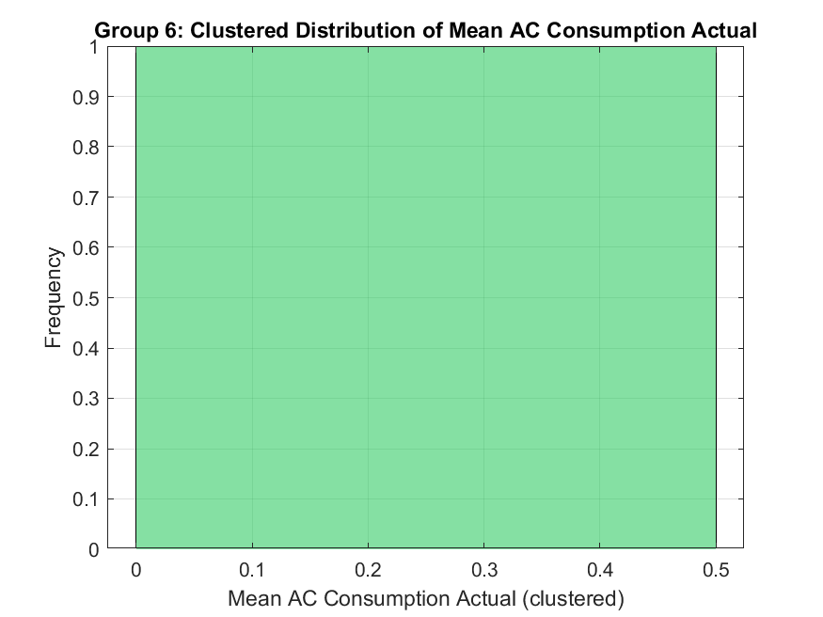
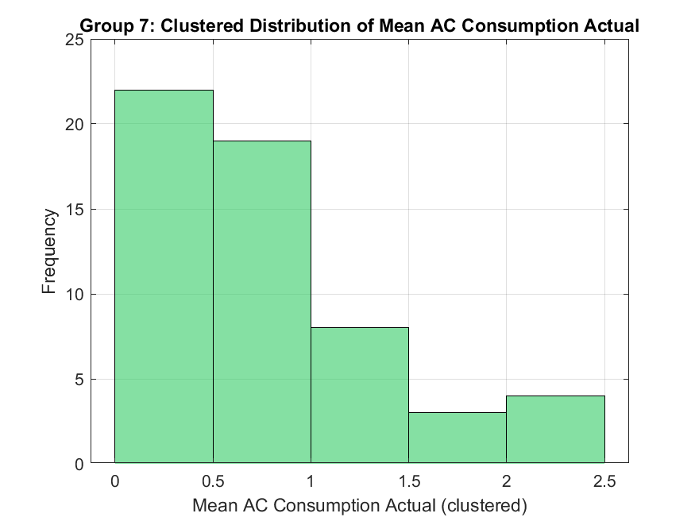

Trips with AC on

